Slide 1
Formal Verification of Programs Equivalence
João Nini
Advisor: Mário Pereira
February 28, 2025

Slide 2
Motivation
Annoying bugs in games
Errors in food delivery apps
Therac-25 radiation overdoses
Boeing 737 Max crashes
CrowdStrike outage
Avoidable!
What is the most reliable way?
Deductive verification

Slide 3
Challenges
Compared to other forms of software verification, deductive verification requires:
Specialized knowledge
More effort
More time

Slide 4
Problem Definition
Can we automatically prove that two programs P1 and P2 are correct and equivalent?

Slide 5
Goals and Expected Contributions
Product programs in OCaml
Facilitate the proof of the hardest program by using the proof of the simplest one

Slide 6
Presentation Structure
Background
State of the Art
Preliminary Results
Work Plan

Slide 7
Relational Hoare Logic
Hoare Logic
Background
OCaml
Cameleer
Why3
GOSPEL

Slide 8
Hoare Logic
Fundamental in deductive verification
Allows reasoning about the correctness of a program
If the pre-condition holds and the program terminates, then the post-condition also holds after the execution (Hoare triple)
{P} S {Q}
Pre-condition
Program
Post-condition

Slide 9
Relational Hoare Logic
Extension of Hoare Logic to reason about two different programs or different runs of the same
Much better to establish that two programs are equivalent or not
If both P1 and P2 respect the pre-condition, either they both terminate respecting the post-condition or neither does . (Hoare quadruple)
{Φ} P1 ~ P2 {Ψ}

Slide 10
Ocaml (1/2)
Multi-paradigm
Interpreted or compiled
Strongly and statically typed with type inference
Used in: Meta, Microsoft, Bloomberg, Docker, Coq…

Slide 11
Ocaml (2/2)
Imperative
Functional
let gcd_iter (a0: int) (b0: int) : int =
let b = ref b0 in
let a = ref a0 in
while !b <> 0 do
let tmp = !a in
a := !b;
b := tmp mod !b
done;
!a
let rec gcd (a: int) (b:int) : int =
if b = 0 then a
else gcd b (mod a b)

Slide 12
Why3
Open source deductive verification platform
Establishes the bridge between the programmer and different types of theorem provers:
SMT solvers (Z3, cvc5, Alt-Ergo…)
Interactive proof assistants (Coq, Isabelle…)
TPTP provers (Vampire, E…)

Slide 13
GOSPEL
Generic Ocaml SPEcification Language
Specification language for OCaml
Allows program correctness verification
Created to significantly improve conciseness and accessibility

Slide 14
Cameleer
An evolution from Why3 with the help of GOSPEL
Directly accepts GOSPEL-annotated OCaml code
Translates it to WhyML and uses the Why3 tool to perform the actual verification

Slide 15
State of the Art

Slide 16
Self-composition
Originally developed to control information flow in a more extensible and flexible way than type systems
It is highly expressive, and there is no need to prove its soundness as one would with type systems
Despite being considerably complete, it is impractical

Slide 17
Cross-products
Started as a method to prove program equivalence, focused on compiler optimizations
Supports most intraprocedural compiler optimizations
Not applicable to two programs with dissimilar structures

Slide 18
Product Programs
Combines the best of self-composition and cross-products
Flexibility of self-composition for asynchronous steps
Efficiency of cross-products for synchronous steps
Reduces relational verification into standard verification, therefore has extensive tool support
Support for two programs that are structurally dissimilar

Slide 19
Program Equivalence (1/2)
Original
Transformed
let source (b c n: int) : (x: int)
= let ref i = 0 in
let ref j = 0 in
let ref x = 0 in
while i < n do
j <- i * b + c;
x <- x + j;
i <- i + 1;
done;
x
let transformed (b c n: int) : (x': int)
= let ref i' = 0 in
let ref j' = c in
let ref x' = 0 in
while i' < n do
x' <- x' + j';
j' <- j' + b;
i' <- i' + 1
done;
x'

Slide 20
Program Equivalence (2/2)
Product Program
let main (b c n: int) : (x: int, x': int)
= let ref i = 0 in
let ref i' = 0 in
let ref j = 0 in
let ref j' = c in
let ref x = 0 in
let ref x' = 0 in
while i < n && i' < n do
j <- i * b + c;
x <- x + j;
i <- i + 1;
x' <- x' + j';
j' <- j' + b;
i' <- i' + 1
done;
x, x'

Slide 21
Preliminary Results

Slide 22
Simple Equivalence Proof - Factorial
let fact_iter (n: int) : int =
if n <= 1 then 1
else begin
let res = ref 1 in
for i = 2 to n do
(*@ invariant !res = fact (i-1) *)
res := !res * i
done;
!res end
(*@ result = fact_iter n
requires n >= 0
ensures result = fact n *)
Functional
Imperative
(*@ function rec fact
(n: integer) : integer =
if n = 0 then 1
else n * fact (n-1) *)
(*@ requires n >= 0
variant n *)

Slide 23
Simple Product Program
Original
Transformed
Product Program
val ref x : int
val ref y : int
val ref z : int
let original () =
y <- x + 1;
z <- y + 1;
val ref x : int
val ref y : int
val ref z : int
let transformed () =
z <- x + 2;
y <- z - 1;
val ref x1, y1, z1 : int
val ref x2, y2, z2 : int
let product ()
requires { x1 = x2 }
ensures { y1 = y2 }
ensures { z1 = z2 } =
y1 <- x1 + 1;
z2 <- x2 + 2;
z1 <- y1 + 1;
y2 <- z2 - 1;

Slide 24
Product Program with a while loop (1/2)
Original
Transformed
let source (b c n: int) : (x: int)
= let ref i = 0 in
let ref j = 0 in
let ref x = 0 in
while i < n do
j <- i * b + c;
x <- x + j;
i <- i + 1;
done;
x
let transformed (b c n: int) : (x': int)
= let ref i' = 0 in
let ref j' = c in
let ref x' = 0 in
while i' < n do
x' <- x' + j';
j' <- j' + b;
i' <- i' + 1
done;
x'

Slide 25
Product Program with a while loop (2/2)
while i < n && i' < n do
variant { n - i }
invariant { j' = i' * b + c }
invariant { i = i' }
invariant { x = x' }
j <- i * b + c;
x <- x + j;
i <- i + 1;
x' <- x' + j';
j' <- j' + b;
i' <- i' + 1
done;
x, x'
Product Program
let main (b c n: int) : (x: int, x': int)
ensures { x = x' }
= let ref i = 0 in
let ref i' = 0 in
let ref j = 0 in
let ref j' = c in
let ref x = 0 in
let ref x' = 0 in

Slide 26
Work Plan

Slide 27
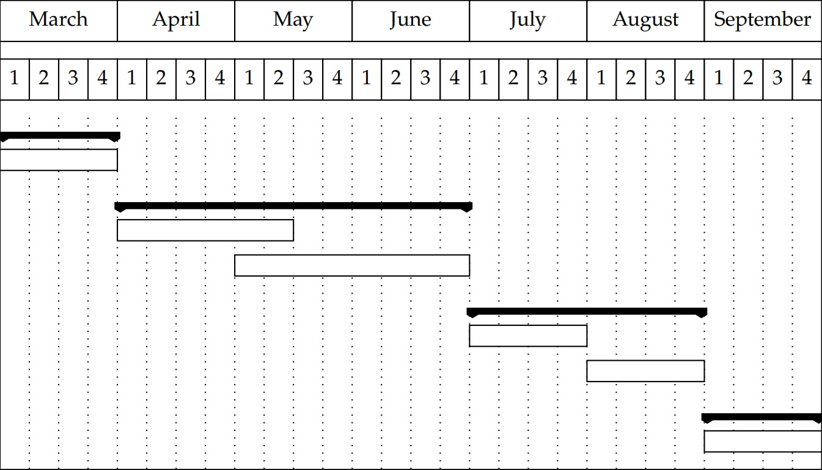
Work Plan
Preliminary
Collection of case studies
First-order product programs
Definition in OCaml
Implementation in Cameleer
Extension to higher-order Definition in OCaml
Implementation in Cameleer
Dissertation
Writing

